Slide 1
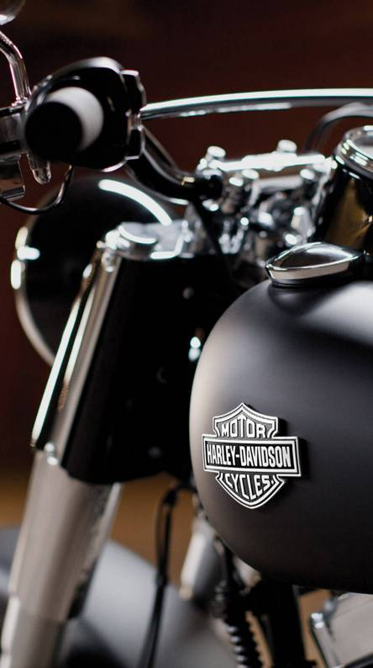



Sales Data
By: Anubhav Chauhan

Slide 2
Introduction
About Dataset
Objective
Problem Statement
Outcome/Result

Slide 3
Introduction
I have chosen a dataset on Harley Davidson sales data.
Official dataset was gathered from Kaggle.
My task is to find correlation between different attributes of dataset and estimate features of product sales with association of different problem statements.

Slide 4
About Dataset
Official dataset was gathered from Kaggle.
Dataset consist of 11 columns, and 2824 rows.
Dataset is from 2002-2016.
Dataset consist of different attributes such as order number, product name, store name, price quantity, order date, country, city.

Slide 5
Objective
Objective of this study is to visualize and bring some insight from the sales of Harley Davidson motorcycles.
To estimate different features and of sales and it association with product, store, city, country, quantity.

Slide 6
Problem Statement
Given a dataset of Harley Davidson sales data, aim is to…
Find top & bottom motorcycle data sold by price.
Find top store names data who sold the most bikes in high quantity.
Compare and visualize price and quantity and find in which year the highest sales took place.
Find out Correlation between price and quantity and observe the outlier.
Find out which bike model satisfied the average sales by reference line.
Find out which bike model sold in highest quantity by a tree map.
Visualize country by top ranks who have sold Harley Davidson in most quantity.
Give rank to bikes by sales in different year and stores.
Give rank to stores by year and country.
Find out highest to least used payment mode.

Slide 7
Outcome/Result
Worldwide Top product sold by price is Harley Davidson street bob and Bottom product sold by price is Harley Davidson fat boy.
By my observation highest sales occurred in 2015, highest sales price was 90,93000 and product quantity sold was 19,990.
Three product satisfied the average sales i.e. Harley Davidson street bob, Harley Davidson roadster, Harley Davidson street 750.
By correlating two measures, price and quantity, I have observed that Harley Davidson roadster has sold in most quantity because its price was low.
And in other place Harley Davidson fat bob has sold in least quantity because its price was highest than any other.
Therefore by my analysis price has a huge contribution over Harley Davidson sales.
In 2015 there was seen highest peak of both sales and quantity, therefore I have got top 3 countries contributed to highest sales in 2015 based on ranks are USA, Spain, & France.

Slide 8
Outcome/Result
Top 3 ranking bikes in 2015 are Roadster, Street bob, & Street 750.
Top 3 ranking stores in 2015 are Capital, Geelong, & Wild cats.
https://drive.google.com/drive/folders/1G5J9qXW4pgmcdYwPspROH3rLIbw-irkU?usp=sharing

Slide 9
Thank You!

